Slide 1
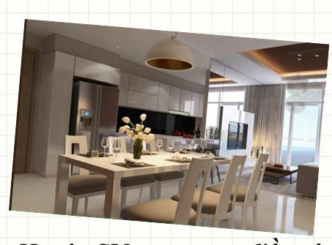
Không gian sống
Họ tên: Nguyễn Hữu Thăng
Lớp: CD17TT3
Khoa : CNTT
Notes:
This template can be used as a starter file for presenting training materials in a group setting.
Sections
Right-click on a slide to add sections. Sections can help to organize your slides or facilitate collaboration between multiple authors.
Notes
Use the Notes section for delivery notes or to provide additional details for the audience. View these notes in Presentation View during your presentation.
Keep in mind the font size (important for accessibility, visibility, videotaping, and online production)
Coordinated colors
Pay particular attention to the graphs, charts, and text boxes.
Consider that attendees will print in black and white or grayscale. Run a test print to make sure your colors work when printed in pure black and white and grayscale.
Graphics, tables, and graphs
Keep it simple: If possible, use consistent, non-distracting styles and colors.
Label all graphs and tables.

Slide 2
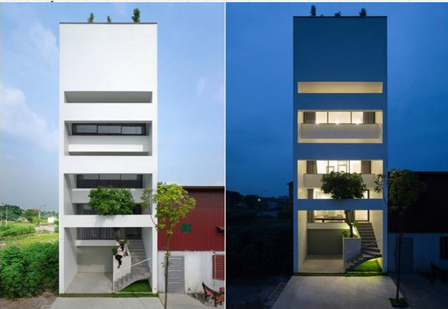
Nhà ông ở bắc ninh hứng mưa nắng như ngoài trời
<Nguyễn Hữu Thăng CD17TT3 17211TT1281>
Notes:
Use a section header for each of the topics, so there is a clear transition to the audience.

Slide 4
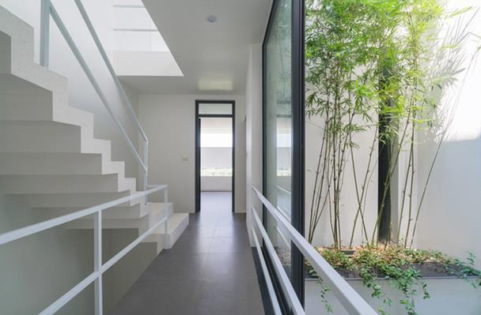
Cây xanh tạo khoảng đệm làm giảm tiếng ồn,khói bụi, nắng hướng tây chiếu trực tiếp vào nhà
<Nguyễn Hữu Thăng CD17TT3 17211TT1281>

Slide 5


